Slide 1
USGS
NDBC

Slide 2
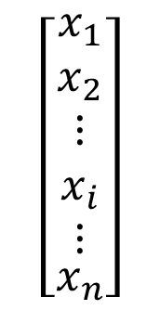



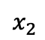


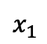




$$x_{2}$$
$$wx−b=+1$$
(a)
$$wx−b=0$$
$$wx−b=−1$$
$$\frac{2}{\left\|w\right\|}$$
$$x_{1}$$
(b)
$$\left[\begin{matrix}x_{1} \\ x_{2} \\ \begin{matrix}\begin{matrix}\begin{matrix}⋮ \\ x_{i}\end{matrix} \\ ⋮\end{matrix} \\ x_{n}\end{matrix}\end{matrix}\right]$$
$$×$$
$$\left[\begin{matrix}w_{j1} \\ w_{j2} \\ \begin{matrix}\begin{matrix}\begin{matrix}⋮ \\ w_{ji}\end{matrix} \\ ⋮\end{matrix} \\ w_{jn}\end{matrix}\end{matrix}\right]$$
$$×$$
activation
function
$$Σ$$
$$φ$$
activation
$$×$$
transfer
function
$$×$$
threshold

Slide 3
(a)
(b)

Slide 4
(a) (b)

Slide 5
(a) (b) (c) (d) (e)
(f) (g) (h) (i)
(j) (k) (l) (m)

Slide 6
(a) (b)

Slide 7
Supplementary fig. 1
(a)
(b)
(c)

